Slide 1


Structured Data Capture (SDC)
Expressions
Lloyd McKenzie | February 2025

Slide 2

Who am I?
Name: Lloyd McKenzie
Company: Dogwood Health
Background:
One of FHIR’s 3 initial editors
Co-chair FHIR-Infrastructure, past chair FHIR Management Group
HL7 Fellow
Lead for both the ONC and international FHIR SDC projects
lloyd@dogwoodhealthconsulting.com

Slide 3

This presentation
Can be downloaded here:
https://github.com/FHIR/documents/tree/master/presentations/sdc
Is licensed for use under the Creative Commons, specifically:
Creative Commons Attribution 3.0 Unported License
(Do with it as you wish, so long as you give credit

Slide 4

Credit
These slides include content from Brian Postlethwaite
With updates by Lloyd McKenzie

Slide 5

The SDC Collection
SDC Overview
SDC Workflow
SDC Expressions (you are here)
SDC Rendering & Behavior
SDC Population
SDC Extraction
SDC Adaptive Forms
SDC Modular & Derived Forms

Slide 6

Objectives
You should be able to:
Explain the differences between FHIRPath, CQL, and x-fhir-query
Create simple FHIRPath expressions
Create simple x-fhir-queries
Identify the key parts of the Expression data type
Describe the role Library plays in exchanging expressions

Slide 7
SDC Expressions Outline
FHIRPath
x-fhir-query
CQL
Expression Considerations
Expression Exercises

Slide 8
SDC Expressions Outline
FHIRPath
x-fhir-query
CQL
Expression Considerations
Expression Exercises

Slide 9
FhirPath?
What is FhirPath?
Navigation
Manipulation
Evaluation
Why FhirPath? (aren’t there other existing options?)
Standards status:
Normative https://hl7.org/fhirpath
Current Build https://build.fhir.org/ig/HL7/FHIRPath
Notes:
FHIR Path is an expression language that can navigate a fhir resource and evaluate a result. It can manipulate the result or perform tests along the way in a fluent style.
Could return a collection of nodes from the resource, a single Boolean value, or even a concatenation of multiple fields.
It’s kindof like XSLT or XPath or JsonPath or .NET’s LinQ
We didn’t use any of these options as we needed an answer that would work for both XML and JSON (or direct object models) without needing to perform translations to another format to operate.
Has a formal grammar

Slide 10
FhirPath uses in FHIR
StructureDefinitions
Invariants (boolean result)
Search Parameters
Value to index (extraction)
Questionnaires
Invariants
Pre-population
Dynamic fields
And many more!
SQL on FHIR
Mapping Language
Logical model
not XML or JSON
Datatype Mappings
FHIR Specific extras
Polymorphism
Patient.deceased[x] (spec)
deceased (fhirpath prop)
deceasedBoolean (xml/json)
Notes:
In FHIR we use it to describe validation expressions (invariants/constraints) in StructureDefintions and Questionnaires, and to define what data is to be indexed in search parameters, and lots of dynamic ways in questionnaires (hope you were able to see my session on Questionnaires or pre-population earlier in the week)
Resource Model: FHIRPath uses a tree model based on the logical views of FHIR resources and data types, rather than the specific JSON or XML formats
Polymorphism: It handles choice elements (e.g., Patient.deceased[x]) by allowing explicit treatment of specific types using the as operation.

Slide 11
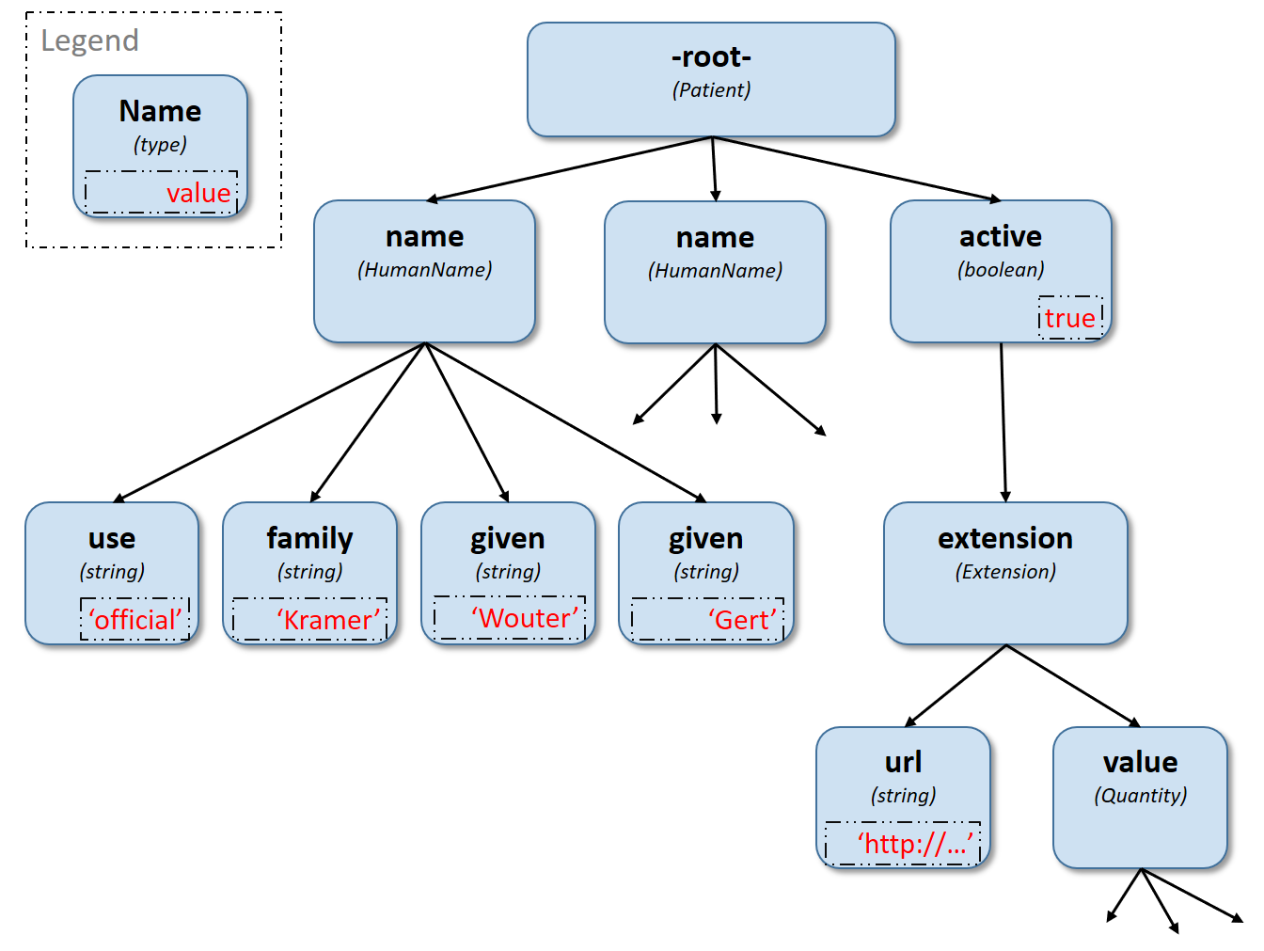
Navigation
Walking the property tree
Selection
Patient.name.given
name.where(family.exists()).given
Patient.deceasedDateTime
Patient.birthDate.extension(‘http://…birthTime’).value
Notes:
Refer to the resource as a property tree, not a specific format. This can apply to multiple formats.
Quickly mention polymorphic types and extension shortcut
Also mention everything is a collection

Slide 12
Operators
Math Operators +, -, /, *, &, (), etc
Logical Operators =, ~, ! =, <, or, and, implies
Casting Operators as, is
Set Operator |
Note: These do not support collections!
Tip: To use in collections, move inside select(…)
Tip: Concatenating strings can be done with + or & (use & if you want to handle either side being empty)

Slide 13
Functions
Projection Functions
Existence Functions
Manipulation Functions
Evaluation Functions
Focus/Context
Parameters/Arguments
Return Value/Result
Types, Polymorphism and casting
Execution behaviour
name.where(family.exists()).given.empty()
Collections – everything is one!
But not all functions work on collections
https://build.fhir.org/ig/HL7/FHIRPath/#functions
Notes:
Highlight the order of operation, i.e. don’t stop navigating just because the collection is empty, as the function at the end might be an exists() call.

Slide 14
Projection Functions (expression arguments)
select(…)
where(…)
first()
last()
skip(2)
combine(…)
repeat(…)
aggregate(…)
$this and $index variables
Tip: where() requires the expression inside to return a Boolean, use existence functions and operators to ensure collections are handled correctly. e.g. .allTrue(), .exists()
https://build.fhir.org/ig/HL7/FHIRPath/#filtering-and-projection

Slide 15
Context Variables
variable | description
%context | The item that the expression is requested to be evaluated from. E.g. For invariants, the context is set to a property, not the resource.
%resource | the resource that contains the original node that is in %context.
%rootResource | the container resource for the resource identified by %resource
Tip: None of these variables change during the execution of an expression
https://hl7.org/fhir/fhirpath.html#variables
Notes:
Before we dive in and explore $this in more detail, it’s important that we understand context variables

Slide 16
Understanding the $this variable
The $this variable is initially set the same as the %context variable
The $this variable (and $index) will be set to each item during the evaluation of a function that has a parameter type of expression,
e.g. where() / select()
NOT for other functions such as toString()
When exiting the function, $this is restored
“the current focus” is NOT $this, though has similarities
Proposed $focus – closer to other languages version of this (FHIR-44601)
Good Examples:
Bundle.entry.resource.all($this is Observation implies status = 'finished')
value.aggregate($this + $total, 0)
Bad Examples:
name.given.where($this > 'ba' and $this < 'bc')
'A/B/C'.substring($this.indexOf('/')+1)
name.given.iif($this = 'Brian', 'Its Me!', $this)
See FHIR-44601

Slide 17
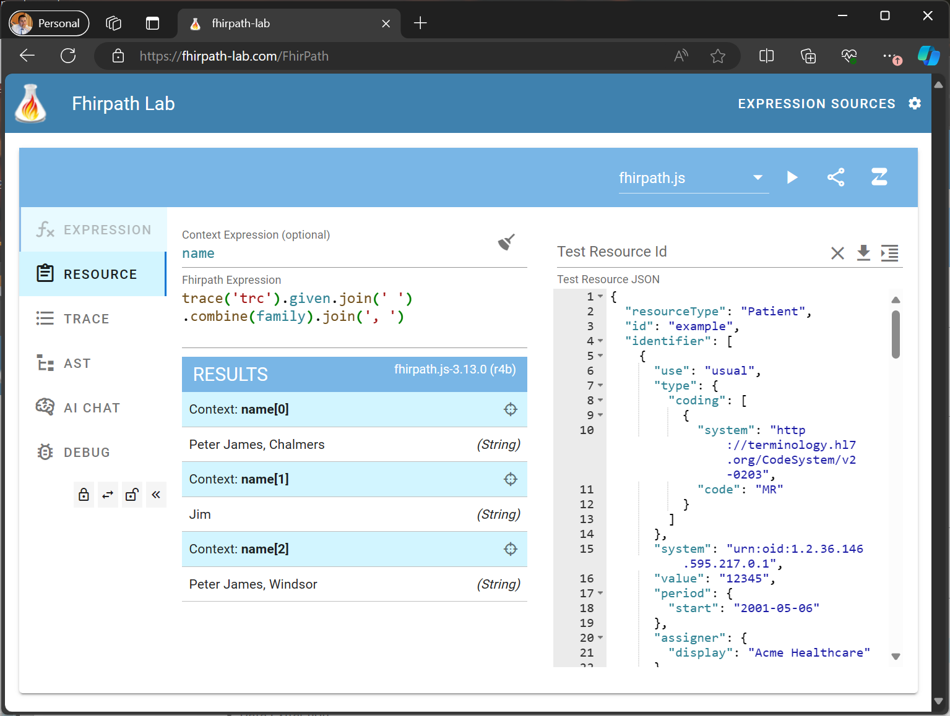
The FhirPath-Lab
Create
Test
Debug
Share
FhirPath
Questionnaires
FHIR Mapping Language
Notes:
Tracing
Variables
Different Engines – Validation from the .NET engine
Abstract Syntax Tree – function hyperlinks to spec
Save the AI Chat for later

Slide 18
Debugging Expressions
Using Trace effectively
Understanding the Abstract Syntax Tree
Comparing different engines
Improved static validation from .NET
Review collections/context
code.select((coding.where(system='http://snomed.info/sct') | coding.where(system!='http://snomed.info/sct').first() | text ).first())
Notes:
Trace is the console.log or printf of the fhirpath world
How can we debug this expression with several cases – This use case for this expression is to select the first of the values if it exists in the code: snomed concept, other concept, or free text.

Slide 19
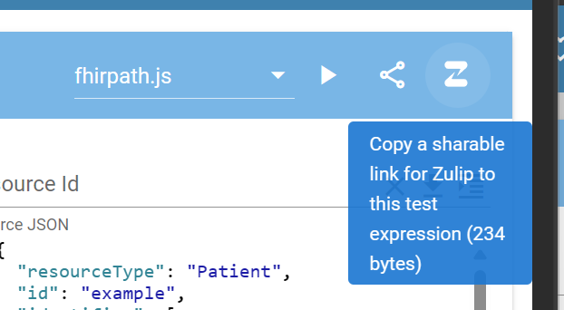
Getting Help with FhirPath
Zulip
https://chat.fhir.org/#narrow/stream/179266-fhirpath
https://chat.fhir.org/#narrow/stream/179298-fhirpath.2Ejs
Test with the FhirPath Lab first, then share issue
Using the “share with Zulip” button
This wraps the expression, context, test resource and engine into a link and markdown block ready to paste into Zulip to let others test too!

Slide 20
FhirPath Tooling/Engines
Project | Company/Contributor | Dev Language | Distribution
FhirPath Lab | Brian Postlethwaite | VueJS | (hosted)
Fhirpath.js | (lots of contributors) | Javascript | Npm
Firely SDK | Firely | .net 8 | NuGet
HAPI | Smile Digital Health | JAVA | Maven
FhirPath Validator | Brian Postlethwaite | .net 8 | NuGet
Aidbox | Health Samurai | Closure
Fhirepath.py (new) | Beda Software | Python

Slide 21
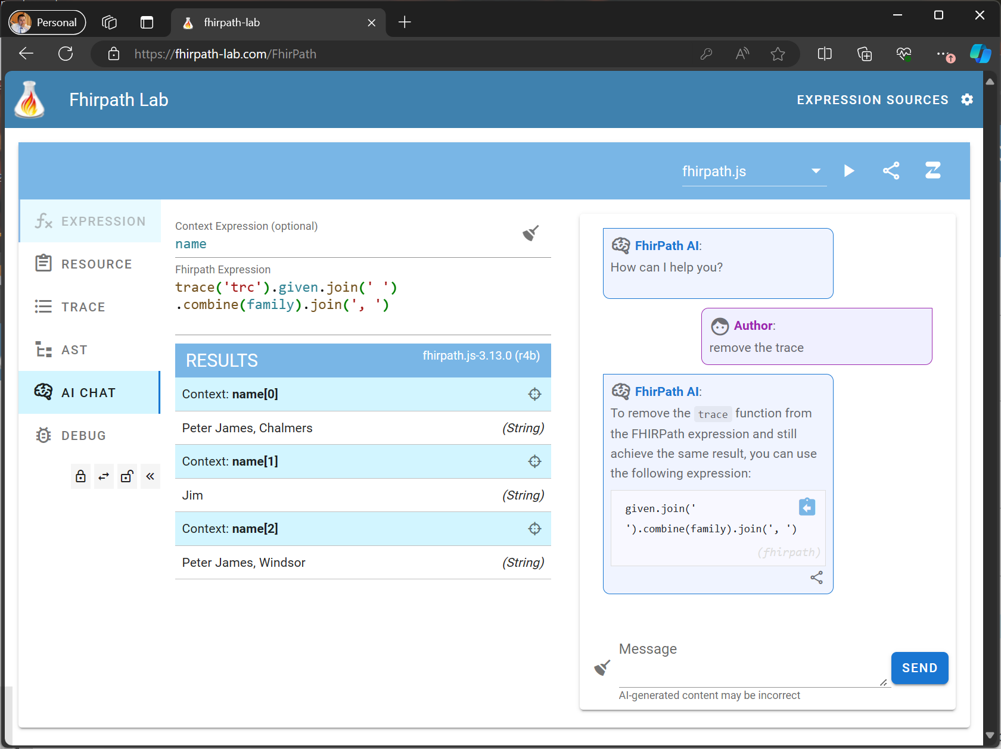
Demonstration
https://fhirpath-lab.com/FhirPath

Slide 22
SDC Expressions Outline
FHIRPath
x-fhir-query
CQL
Expression Considerations
Expression Exercises

Slide 23
Where did it come from/where used?
Originally defined for use in SDC
Now defined in FHIR (R5)
Used in:
SDC
CDS Hooks (limited FHIRPath subset)
Can be used anywhere there’s an Expression data type

Slide 24
Use-case
I want the most recent body weight for the patient within the last 3 months
[base]/Observation? code=3141-9&patient=123&date=ge2024-09-19
Solution:
[base]/Observation? code=3141-9&patient={{%patient.id}}& date=ge{{today()–3 months}}

Slide 25
x-fhir-query process
Take a standard query URL
Replace some of the content in that URL with {{}}
Put FHIRPath inside the {{}}
Performer of the query executes the FHIRPath, URL-encodes that results as necessary, and inserts into the query, replacing the {{}} content
Result is a Bundle made available via the Expression.name element

Slide 26
Additional rules
If the FHIRPath results in a collection, the substitution is a comma-delimited list
Identifier, Coding, Reference -> token search parameter
CodeableConcept -> list of token search parameters
One per coding
Quantity -> quantity search parameter
Content not in {{}} must already be properly URL-encoded

Slide 27
FHIRPath in FHIR
https://hl7.org/fhir/fhirpath.html
Additional variables: %resource, %rootResource
Additional functions:
extension(url)
hasValue()
getValue()
resolve()
ofType()
elementDefinition()
slice(structure, name)
checkModifiers()
conformsTo(structure)
memberOf(valueset)

Slide 28
FHIRPath in SDC
https://build.fhir.org/ig/HL7/sdc/expressions.html#fhirpath-supplements
Additional variables: %questionnaire, %qitem
Additional functions:
sum(), min(), max(), count(), avg()
answers()
ordinal() weight()

Slide 29
SDC Expressions Outline
FHIRPath
x-fhir-query
CQL
Expression Considerations
Expression Exercises

Slide 30
Clinical Quality Language (CQL)
Health Level 7(HL7) standard designed to:
Enable automated point-to-point sharing of executable clinical knowledge
Provide a clinically focused, author-friendly, and human-readable language
Currently published as a Mixed Normative/Trial Use HL7/ANSI Standard
http://www.hl7.org/implement/standards/product_brief.cfm?product_id=400
http://cql.hl7.org

Slide 31
What is CQL
Fully featured programming language
Expression-based
Builds on FHIRPath, but with variables, logic, query capability, etc.
Not FHIR-specific
Clinician-friendly (ish)

Slide 32
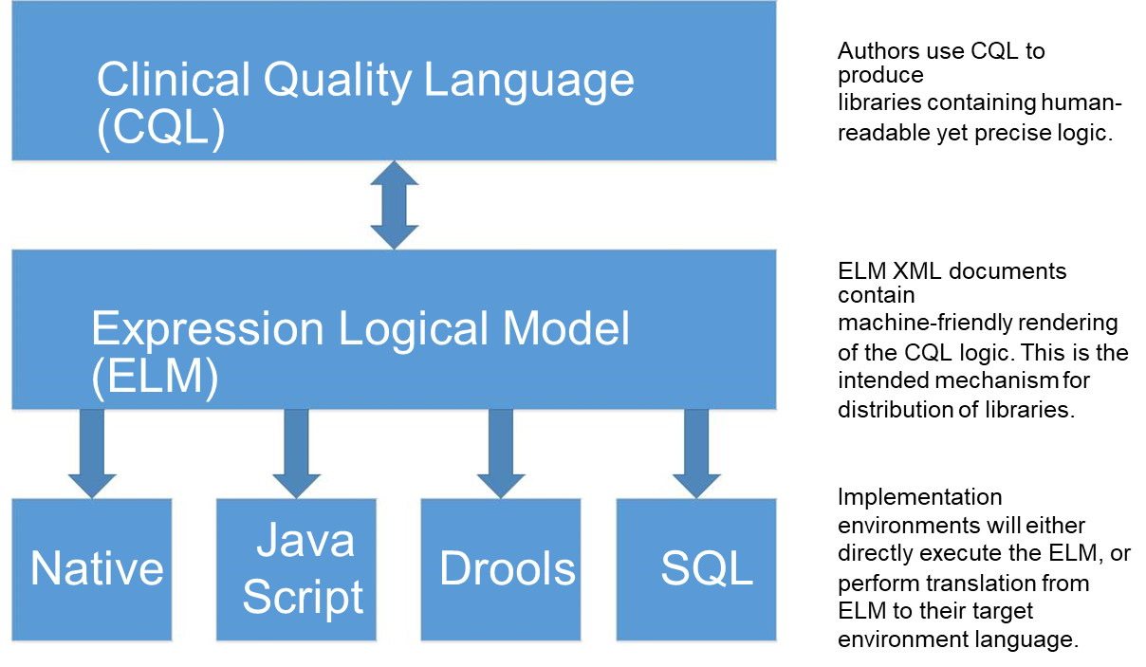
CQL Architecture
From https://cql.hl7.org/01-introduction.html
Definitions: SQL – Structured query language

Slide 33
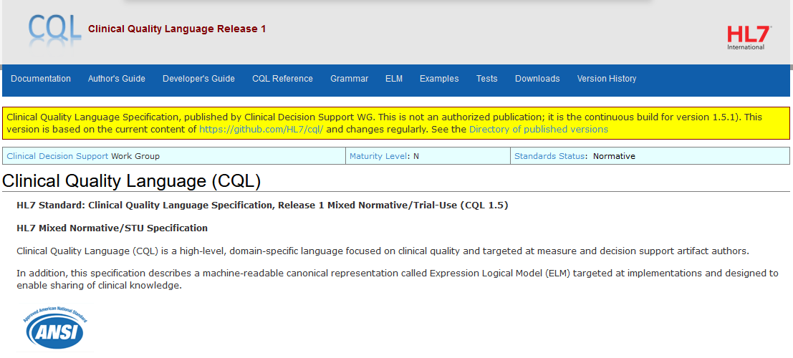
Specification
https://cql.hl7.org

Slide 34
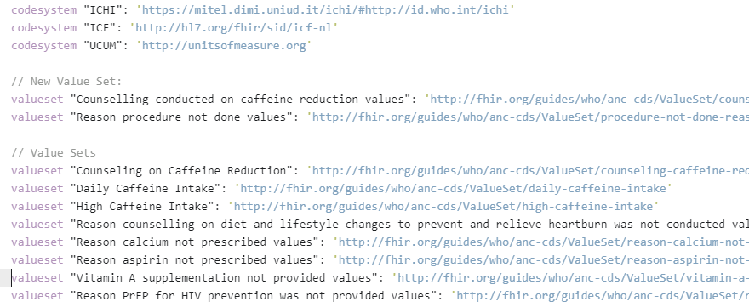
Concepts, DataElements, Decisions
® Health Level Seven and HL7 are registered trademarks of Health Level Seven International, registered with the United States Patent and Trademark Office.

Slide 35
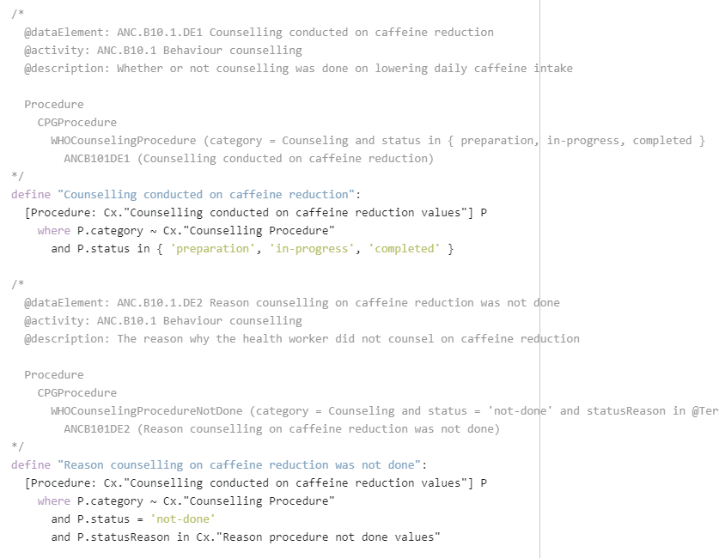
DataElements

Slide 36
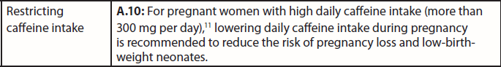
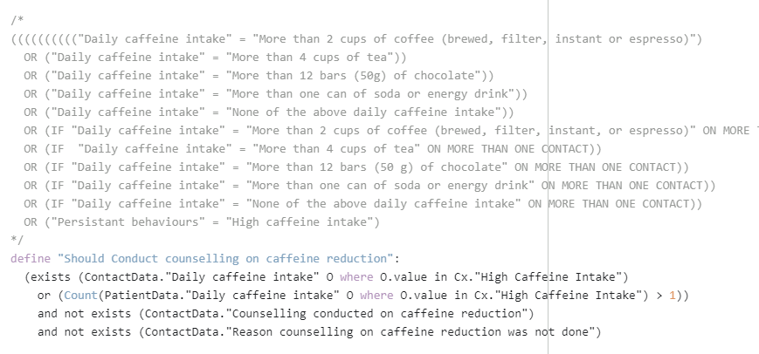
Decisions
® Health Level Seven and HL7 are registered trademarks of Health Level Seven International, registered with the United States Patent and Trademark Office.

Slide 37
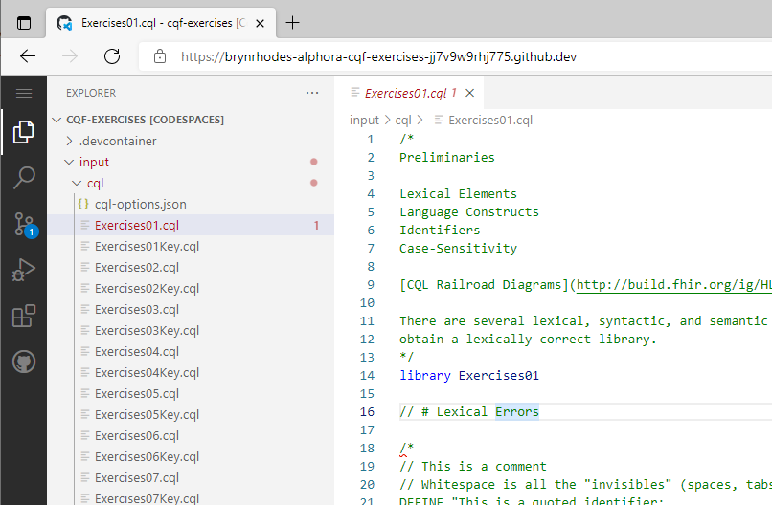
VS Code – Best Editor Ever
https://code.visualstudio.com/
Full-featured IDE
CQL plugin w/
Highlighting
Syntax checking
Ad-hoc evaluation
Test cases
Terminology support

Slide 38

VS Code – Extensions
Extension Identifier: cqframework.cql

Slide 39
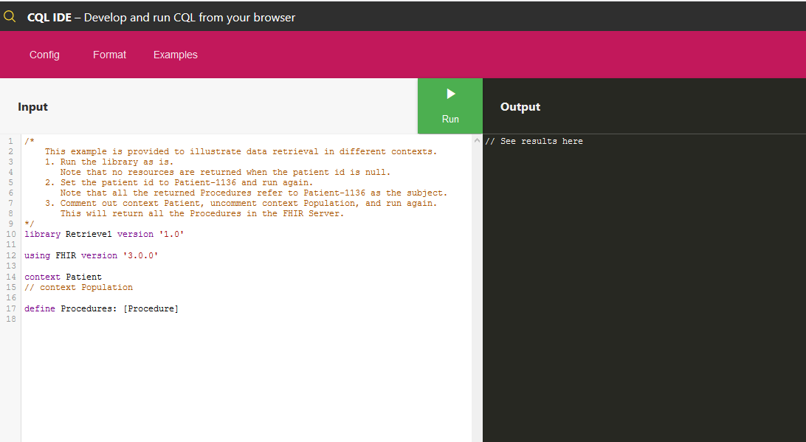
CQL-Runner – Ad-hoc CQL execution
http://cql-runner.dataphoria.org

Slide 40
SDC Expressions Outline
FHIRPath
x-fhir-query
CQL
Expression Considerations
Expression Exercises

Slide 41
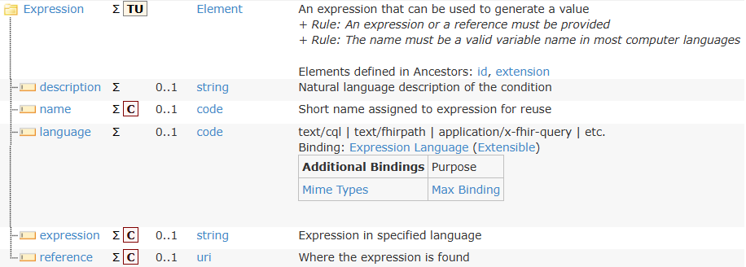
Expression type

Slide 42
FHIRPath variables
Results of Expressions with ‘name’ elements become available as variables
Scope:
All following Expressions on the same node
All descendant items
Conflicts with variable names on same element is an error
Same name in descendants or different trees is fine
Variables are not available for $extract

Slide 43
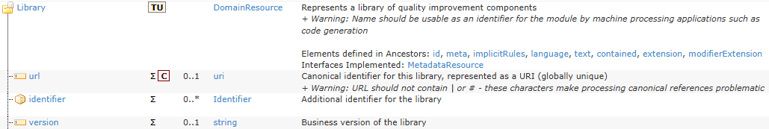
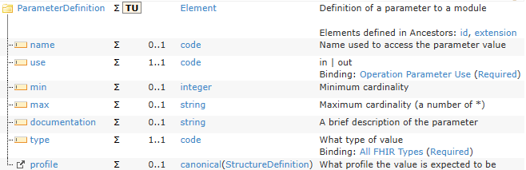
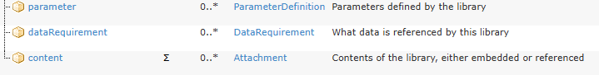
Libraries
…

Slide 44
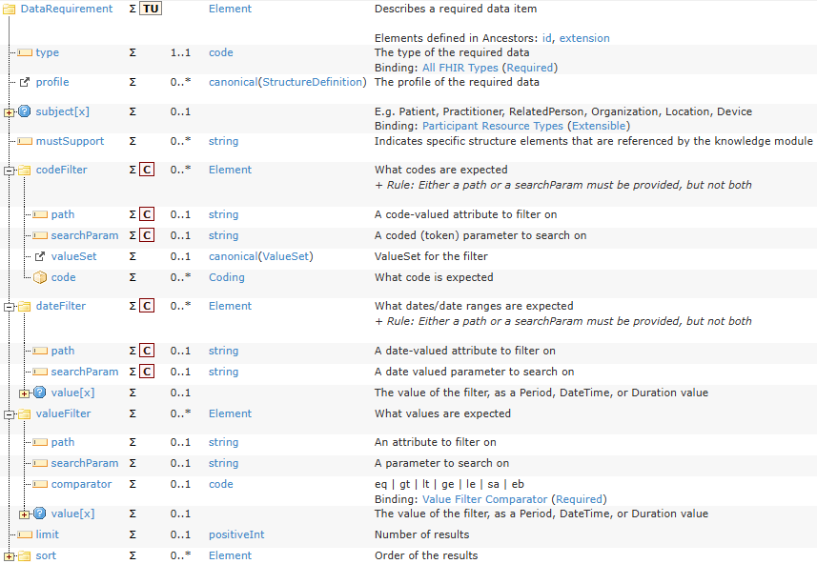

Slide 45
Library vs. inline
Library
Allows re-use across artifacts
Allows separation of maintenance concerns
Works well for ‘complex’ expressions (e.g. CQL)
Can theoretically be used for FHIRPath & x-fhir-query
Better for compilation (ELM)
In-line
No possibility of independent resolution
Simpler to maintain?

Slide 46
Mixing expression languages
x-fhir-query + FHIRPath is common
Define variables at the root (or on group) with x-fhir-query results
Navigate those resources using FHIRPath to get other data
Mixing others with CQL is less common (but possible)
E.g. if there are CQL library functions you want, but the main logic should still be FHIRPath

Slide 47
SDC Expressions Outline
FHIRPath
x-fhir-query
CQL
Expression Considerations
Expression Exercises

Slide 48
FHIRPath Exercises
Using the FHIRPath lab create an expression that returns:
Patient’s first middle name
Patient’s middle initials
String containing a practitioner’s name and phone number in the form: “Dr. John Smith (111-111-1111)”

Slide 49
FHIRPath Answers
Patient’s first middle name
name.first().given[1]
Patient’s middle initials
name.first().given.skip(1).select(
$this.substring(0,1)
).aggregate(
iif(
$total.empty(),
($this.substring(0,1) & '.'),
($total & ' ' & $this.substring(0, 1) & '.')
)
)
String containing a practitioner’s name and work phone number in the form: “Dr. John Smith (111-111-1111)”

Slide 50
FHIRPath Answers (cont’d)
2. Patient’s middle initials
name.first().given.skip(1).select(
substring(0,1) & '.'
).join(' ')
(Note – join isn’t in official release yet, but is widely supported)

Slide 51
FHIRPath Answers (cont’d)
3. String containing a practitioner’s name and work phone number in the form: “Dr. John Smith (111-111-1111)”
select( name.first().select( prefix | given.first() | family ) | telecom.where( system='phone' and use='work’ ).first().value.select( '(' & $this & ')’ ) ).join(' ')

Slide 52
x-fhir-query Exercises
Find all procedures for the patient in the past year
Find all procedures that happened in the first year of the patient’s life

Slide 53
x-fhir-query Answers
Find all procedures for the patient in the past year
[base]/Procedure?patient={{%patient.id}}&date=ge{{today()-1 year}}
Find all procedures that happened in the first year of the patient’s life
[base]/Procedure?patient={{%patient.id}}&date=ge{{%patient.birthDate}}&date=le{{%patient.birthdate+1 year}}

Slide 54



Questions / Discussion
lloyd@dogwoodhealthconsulting.com http://hl7.org/fhir/uv/sdc
Or, better yet, include the community and ask/discuss on http://chat.fhir.org

